Slide 1

WEYLAND ENERGY
Legal & Contracts
Quarterly update to the Executive Board · October 2026

Slide 2
Q3 at a glance
42
14
3
0
contracts in register
NDAs active
litigation holds
sanctions hits
WEYLAND ENERGY · Legal & Contracts – Q3 2026
2

Slide 3
Highlights
• Arcturus PPA WE-PPA-2026-004 in force – first COD progress report sent 15 July
• Notice of delay served on Severn Subsea Cables (WE-CON-2025-031), litigation hold issued
• DPIA for the new file sync & share platform completed with DPO
• Fenwick development budget approved by shareholders (8 Sep)
WEYLAND ENERGY · Legal & Contracts – Q3 2026
3
Notes:
Mention that the Severn meeting is on 14 Oct – Elena and Priya attending.

Slide 4
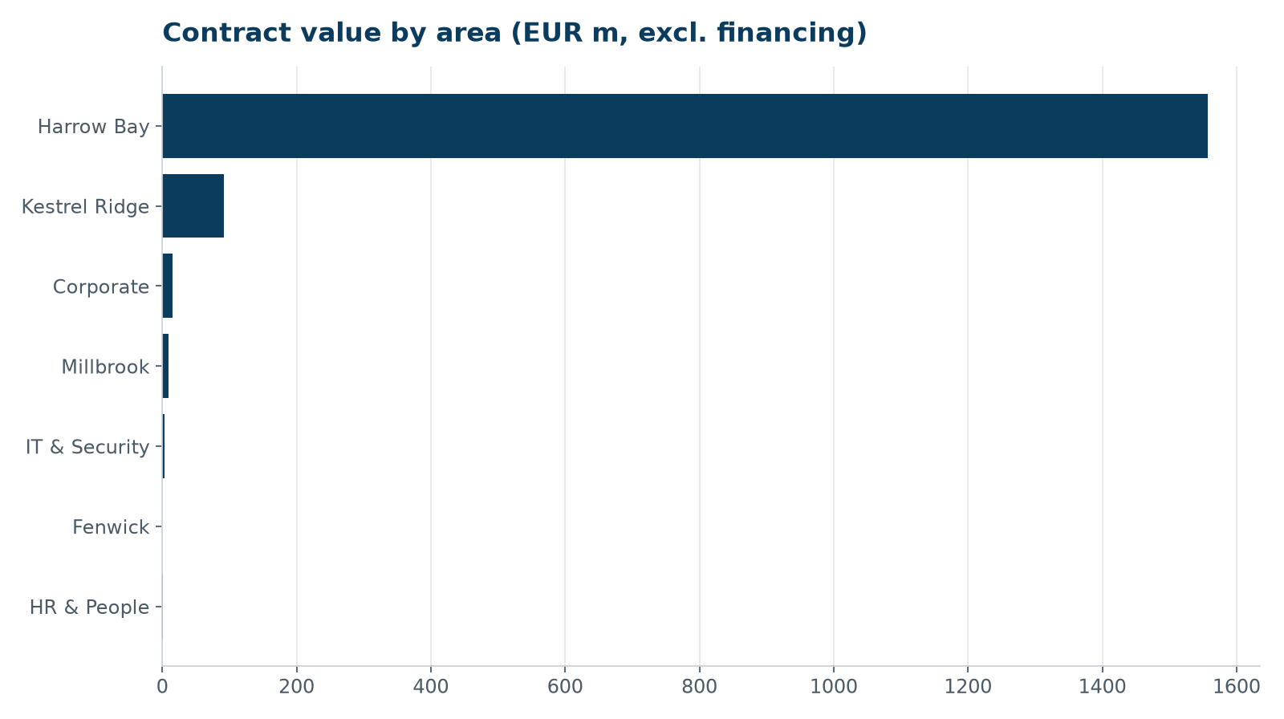
Contract value by area
WEYLAND ENERGY · Legal & Contracts – Q3 2026
4

Slide 5
Priorities Q4
• Severn Subsea claim – without-prejudice meeting 14 Oct
• Retention schedule for file services migration (31 Oct)
• Auditor selection FY2027 – proposal to board
• Compliance training refresh: Speak Up module
WEYLAND ENERGY · Legal & Contracts – Q3 2026
5

Slide 6
WEYLAND ENERGY
Questions?
Priya Nair · legal@weyland-energy.example

